Slide 1
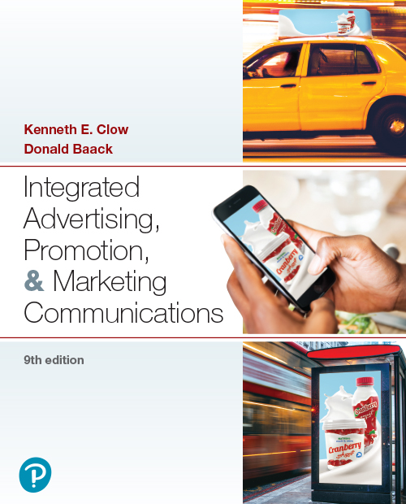

Integrated Advertising, Promotion, and Marketing Communications
Ninth Edition
Chapter 1
Integrated Marketing Communications
Copyright © 2022, 2018, 2016 Pearson Education, Inc. All Rights Reserved
Notes:
If this PowerPoint presentation contains mathematical equations, you may need to check that your computer has the following installed:
1) MathType Plugin
2) Math Player (free versions available)
3) NVDA Reader (free versions available)

Slide 2
Chapter Objectives
How does communication take place?
1.2 What is an integrated marketing communications program?
1.3 Which trends are affecting marketing communications?
1.4 What are the components of an integrated marketing communications program?
1.5 What is meant by G I M C?
Notes:
These are the objectives for Chapter 1.

Slide 3

Lending Tree
New product ideas can arise from frustration
Lenders and borrowers meet on one common website
Marketing challenges have evolved over past 20 years
Quality communication, consumer engagement key
Notes:
As Lending Tree grew over the past two decades, its marketing communications challenges evolved quickly. At first, capturing the attention of home buyers and lending institutions took precedence. Then, persuading consumers that Lending Tree offered a better, more efficient solution to mortgages became vital. Lending Tree now ranks among the top 100 in a recent Fortune 500 list of the fastest-growing companies.

Slide 4
Chapter Overview
Advertising and marketing face a shifting landscape
Traditional media viewership has declined
Internet and social media usage has risen sharply
Effective promotions are multifaceted
Connectivity and interaction with consumers is key
Advertisers are turning to more innovative approaches
Notes:
This chapter provides an overview of integrated marketing communications. Advertising and marketing face a rapidly shifting landscape. A new order has emerged from the decline in traditional media viewership, combined with a dramatic rise in internet and social media usage. Connectivity and interaction with consumers through methods such as mobile marketing have changed much of marketing communication to real-time conversations as consumers make purchasing decisions.

Slide 5
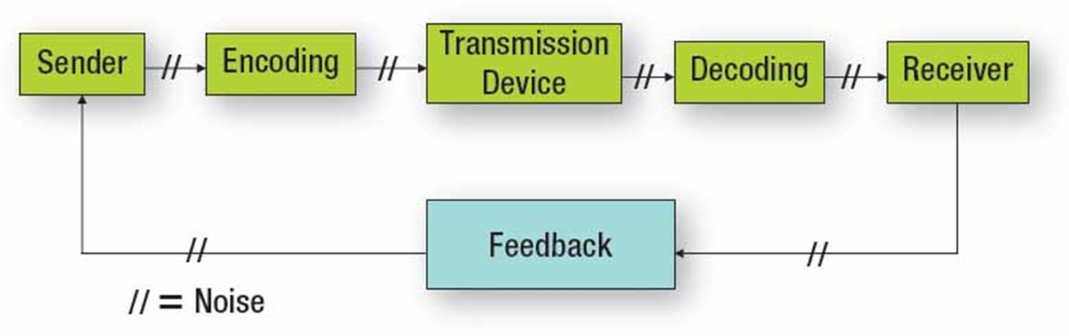
Figure 1.1: Communication Process
Notes:
The communication process consists of five stages, or components. The sender is the individual or company that wants to send a marketing message to consumers or to other businesses. It can be a billboard, a social media post, or even a salesperson. Encoding is the process of taking that message and putting it into the billboard, social media post, or sales presentation. The transmission device may be a television station, a Twitter post, a newspaper, or a Facebook page. The receiver is the consumer or business buyer. Decoding is the process of interpreting the marketing message. Effective communication has taken place if the message that is decoded is the same as it was encoded. However, noise often occurs and distorts the message. Noise can be anything and can occur at any stage. Senders can obtain feedback from receivers and use the information to start the process again.
The flowchart legend displays two forward slashes denoting noise and flows as follows.
Sender flows with two forward slashes to
Encoding which flows with two forward slashes to
Transmission device which flows with two forward slashes to decoding which flows with two forward slashes to receiver which flows with two forward slashes to
Feedback which flows with two forward slashes back to sender

Slide 6
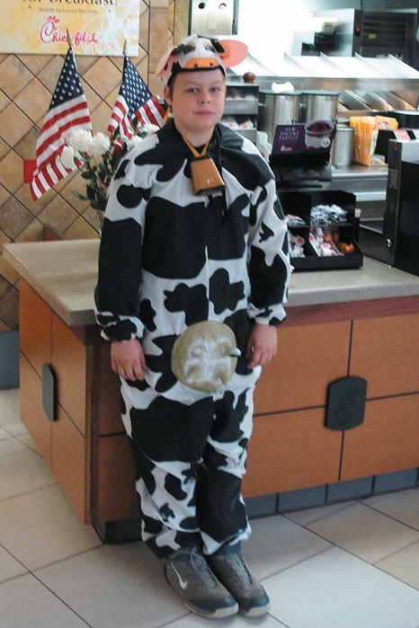
Chick-fil-A and Social Media
Integrates online with offline
Customer engagement is the primary goal
Store openings announced via social media
“Cow Appreciation Day”
“Eat Mor Chikin” offline advertising
Notes:
Social media has become an important marketing medium for businesses. A brand that has successfully used social media is Chick-fil-A. The online message has been carefully integrated with the offline marketing thrust of the brand. It provides a venue for posting announcements about store openings, special deals, and coupons.
A photo of a young boy wearing a cow costume complete with udders and a bell around the neck.

Slide 7
Questions to Consider (1 of 2)
How does Chick-fil-A use social media to interact with customers and other followers?
What do you think of the company’s social media presence? Where would you suggest improvements?

Slide 8
Figure 1.2: Examples of Communication Noise
Talking on the phone during a commercial on television
Driving while listening to the radio
Looking at a sexy model in a magazine ad and ignoring the message and brand
Scanning a newspaper for articles to read
Talking to a passenger as the car passes billboards
Scrolling past internet ads without looking at them
Becoming annoyed by ads on a social media site
Ignoring tweets on Twitter because they are irrelevant
Being offended by the message on a flyer for a local business
Notes:
These are examples of noise that can impact effective communication and prevent the encoded message from being heard at all or lead to the message being decoded differently than was intended.

Slide 9
Recent Developments
The dynamics shown in Figure 1.2 have evolved
Communications involves a “dance” between sender and receiver
Each transmits and receives verbal and nonverbal cues interactively
Companies must react and reply to all messages
Both partners deal with noise and clutter
Notes:
The model in Figure 1.2 has become faster and more interactive than ever before. Let’s take a look at these new dynamics.

Slide 10
Integrated Marketing Communications
Integrated Marketing Communications is the coordination and integration of all marketing communications tools, avenues, and sources in a company into a seamless program designed to maximize the impact on customers and other stakeholders
I M C covers all business-to-business, market channel, customer-focused, and internally-directed communications
Notes:
Let’s define integrated marketing communications. Key components are:
Coordination and integration of all marketing communication tools and venues
Seamless marketing program designed to maximize impact at lower costs
Includes all b-to-b, market channel, customer, external, and internal communications

Slide 11
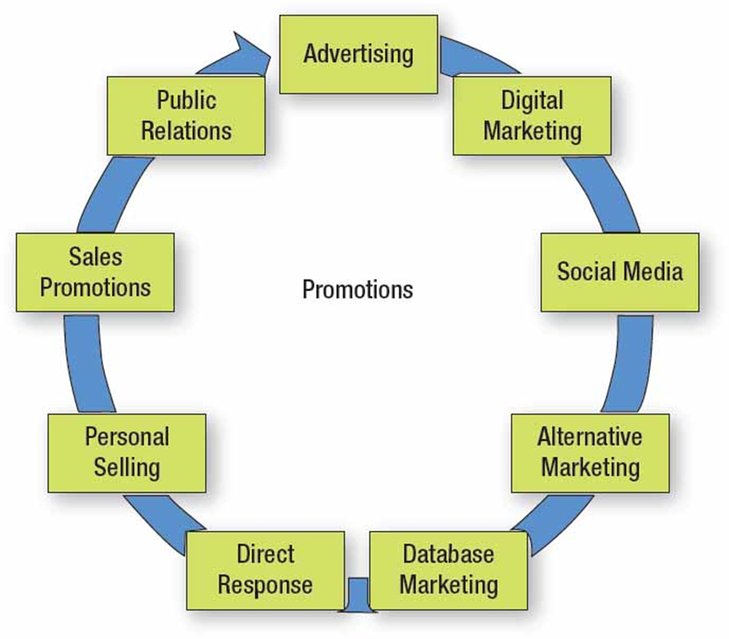
Figure 1.3: Components of Promotion
Notes:
The traditional marketing mix consists of product, price, promotion, and distribution. Traditionally, the promotion component consisted of advertising, sales promotions, and personal selling. Today, it has expanded to include digital and mobile marketing, social media, and alternative methods of communication. The venues for reaching consumers now reach far beyond advertising.
The flowchart components that flow in a clockwise direction are as follows.
• Advertising
• Digital marketing
• Social media
• Alternative marketing
• Database marketing
• Direct response
• Personal selling
• Sales promotions
• Public relations, arrow back to advertising

Slide 12
Figure 1.4: Steps of a Marketing Plan
Current situational analysis
S W O T analysis
Marketing objectives
Target market
Marketing strategies
Marketing tactics
Implementation
Evaluation of performance
Notes:
To understand integrated marketing communications, it helps to review the steps in a marketing plan. The current situational analysis and SWOT set the stage for setting marketing objectives and choosing the target market. Once these are set, the marketing person can develop strategies and tactics. IMC will be part of the overall marketing strategy to reach consumers. It will also be part of the tactics, which are the plans for achieving the objectives and carrying out the strategies. Implementation and evaluation conclude the marketing planning process.

Slide 13
Figure 1.5: Trends Affecting Marketing Communications
Emphasis on accountability, measurable results
Mobile marketing
Integration of media platforms
Shift in channel power
Increase in global competition
Increase in brand parity
Emphasis on customer engagement
Focus on convenience
Cause-related marketing, advertising
Notes:
With global competition has come a greater scrutiny of advertising and marketing budgets. This has led to a greater emphasis on accountability of expenditures and measurable results. The drive for measurable results is one of the factors that has led to the explosion of the digital arena, which includes social media. Measuring the impact of digital expenditures is easier than for traditional advertising. Because consumers now access information from smartphones, tablets, and other media platforms, companies must integrate their marketing communications across all platforms. With greater access to information, consumers now have considerably more channel power. With the rise of the Internet, competition now comes from the entire world. This global competition has increased the level of brand parity now seen across most product categories. To decrease brand parity and build some brand equity, brands are putting greater emphasis on customer engagement.

Slide 14
Accountability and Measurable Results
Company leaders expect tangible outcomes
Effort led by C E Os, C F Os, and C M Os
Advertising agencies expected to deliver results
Emerging social media changes communication
Emerging alternative methods and media
Less reliance on television and other mass media
Notes:
Companies want ad agencies and marketing officers to be accountable for their expenditures. CEOs, CFOs, and CMOs want measurable results. Show us the proof that the $50 million ad campaign is working and will translate into sales. In the past, once an ad agency was hired, they stayed with a client for a number of years because they knew the brand. Now, companies want results. If not, then a new agency will be chosen. With the rise in popularity of social media, there is less reliance on mass TV advertising. Agencies continue to explore alternative ways of reaching consumers where it is less cluttered than mass media.

Slide 15
Mobile Marketing
Includes smartphones, tablets, text messaging
Can create an emotional experience with the brand
Many companies have moved traditional media dollars to digital media
Social media, digital channels give consumers access to information on companies, products, and brands
Notes:
How has mobile marketing changed the picture? It used to be that internet-based marketing communications were created as individual web advertisements along with interactive websites, blogs, and social media messages. These days, smartphones, tablets, and text messaging systems have created a new landscape and nearly a new language. Ingenious digital mobile marketing techniques can now create experiences with a brand rather than mere purchases with little or no emotional attachment.

Slide 16
Questions to Consider (2 of 2)
What are some of your best or worst mobile marketing experiences as a consumer?
In your opinion, which brands do the best job of reaching you with relevant messages wherever you are?
OLX, FOODPANDA

Slide 17
Integration of Media Platforms
Consumers integrate platforms
More than 5 hours per day on non-television screens
As much as 10 hours per day combined with television
Ways consumers integrate media formats:
Content grazing
Investigative spider-webbing
Quantum journey
Social spider-webbing
Notes:
Consumers now spend as much as 10 hours each day examining some kind of screen. Research by Ipsos OTX identified 4 ways that consumers interact with multiple media formats. Content grazing involves looking at two or more screens simultaneously to access different content. Investigative spider-webbing occurs when consumers pursue specific content across multiple platforms. Quantum journey focuses on completing a specific task across multiple platforms. Social spider-webbing occurs when consumers share content across multiple devices.

Slide 18
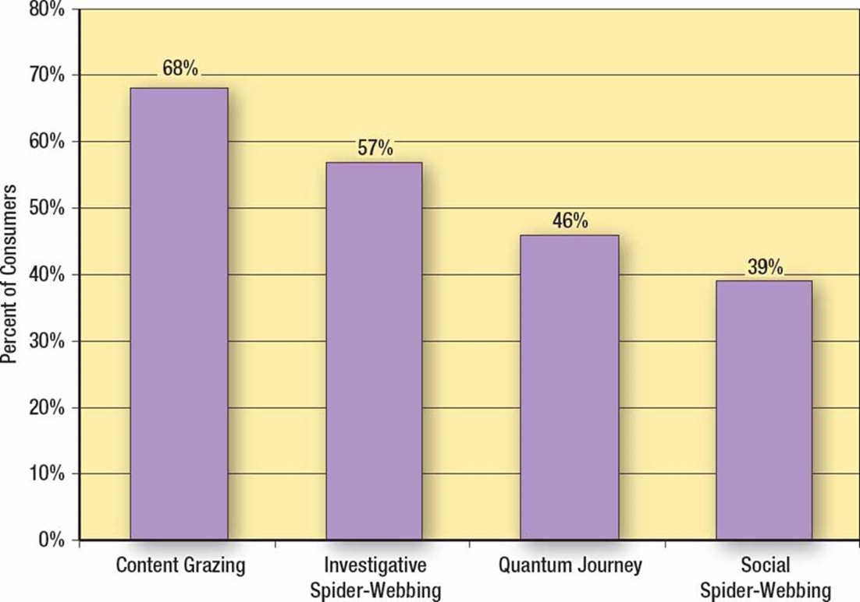
Figure 1.6: Pathways Consumers Use to Interact across Media Devices
Notes:
In this survey by Flamingo Research and Ipsos OTX, consumers were asked how they interact with screens across multiple media formats. Content grazing is the most frequently used method, at 68%. Social spider-webbing is the least used, at 39%.
A bar graph plots percent of consumers versus different media formats. The vertical axis ranges from 0% to 80% in increments of 10.
The values of the bars are as follows.
Media formats
Percent of consumers
Content Grazing
68%
Investigative Spider Webbing
57%
Quantum Journey
46%
Social Spider Webbing
39%

Slide 19
Changes in Channel Power
Retailers
Control channel
Control shelf space
Have purchase data
Determine products and brands on shelves
Consumers
Internet shifts power to consumers
Multiple methods of making purchases
Notes:
Channel power has changed and is continuing to change. For the first 60 or so years in the 1900s, channel power resided with the manufacturers, such as Procter & Gamble. It then shifted to retailers, especially large chain retailers like Wal-Mart. Retailers controlled shelf space, had purchase data, and determined what products and brands went on the shelves. Consumers had to buy whatever brands a retailer stocked. Power is now beginning to shift to consumers, primarily because consumers do not have to purchase from the local retail store. They have options. Retailers who realize this are providing multiple ways for consumers to purchase and receive products.

Slide 20

Increases in Global Competition
Information technology and communication has changed the marketplace
Products can be purchased from anywhere on the globe
Customers want both low prices and high quality
Manufacturers and retailers must work together
Notes:
Advances in communication technology have led to the rise of global competition. Every business competes in some way with global firms, either directly or indirectly, either for customers or for supplies. Products can be purchased from multiple locations. As a result, the level of competition has increased, and the prices of products have fallen. The challenge businesses now face is that consumers want it all. They want the lower prices created by global competition, but they also want quality. To provide this to consumers, manufacturers and retailers must work together. They must become partners with mutual goals that benefit both parties.

Slide 21
Increases in Brand Parity
Brands viewed as providing identical attributes
Shoppers select from a group of brands
Quality and characteristics less important
Price more important
Decline in brand loyalty
Notes:
With brand parity, consumers see the brands as about equal in quality and attributes. Rather than having one brand that is viewed as being superior, consumers often have a group of brands they feel are equal and would meet their needs. As a result, in brand parity situations, quality and characteristics become less important since these are viewed as being equal. That makes price often the determining factor. The rise in brand parity has led to a decline in brand loyalty.

Slide 22
Emphasis on Customer Engagement (1 of 2)
Marketers seek to engage customers with the brand at every contact point
Digital and social media now part of total integrated marketing approach
Two-way communication is key
Firms strive to develop emotional commitment
Notes:
With the increase in brand parity and the decline in brand loyalty, companies have placed greater emphasis on customer engagement. Contact points between customers and the product are examined in an effort to improve communication and the relationship. Digital media is now a critical component of integrated marketing plans because it provides two-way communication. It is no longer sufficient to talk to customers; you must develop a dialogue with customers. The goal: a deeper emotional commitment on the part of consumers toward the brand.

Slide 23

Emphasis on Customer Engagement (2 of 2)
Customer engagement remains important in times of disaster.
Notes:
Customer engagement is vital to the success of brands. It is also important for nonprofits, as shown in this this ad by the Joplin Area Chamber of Commerce Foundation.
The title reads, Just imagine if this was your community, and the subtitle reads here is an amazing opportunity to be generous and take the tax credit.

Slide 24
Focus on Convenience
Consumers value time in new and important ways
Emphasis on making purchases quick and simple
Home delivery systems and store pick-up programs increasing
Many services now made from a consumer’s smartphone or tablet
Notes:
How many of you have recently made a purchase in one of these ways? Even cars can be purchased online via Carvana, CarGurus, and other sites. Convenience also applies to many other services such as insurance, banking, home loans, stock purchases, and college courses. Advertisers work to emphasize convenience as part of the messages they convey to consumers.

Slide 25

Cause-Related Marketing and Advertising
More consumers want to buy products attached to socially responsible efforts and causes
This trend greatly increased during the COVID-19 outbreak
Notes:
How do you make purchasing decisions as a consumer? Is social responsibility important to you? This advertisement for Walgreens Red Nose Day creates a positive bond with consumers by connecting the store with helping children.

Slide 26
Figure 1.7: Five Reasons Why Integrated Marketing Works
Unifies strategy and message across channels
Streamlines timing
Connects with multiple audiences
Creates meaningful insights
Maximizes impact
Notes:
Zehnder Communications, an advertising agency that created a number of ads in this textbook, posted five reasons on the company’s blog why integrated marketing works and why it is essential. According to Zehnder, “integrated marketing combines multiple types of outreach tactics to most effectively reach a brand’s key audiences.”

Slide 27
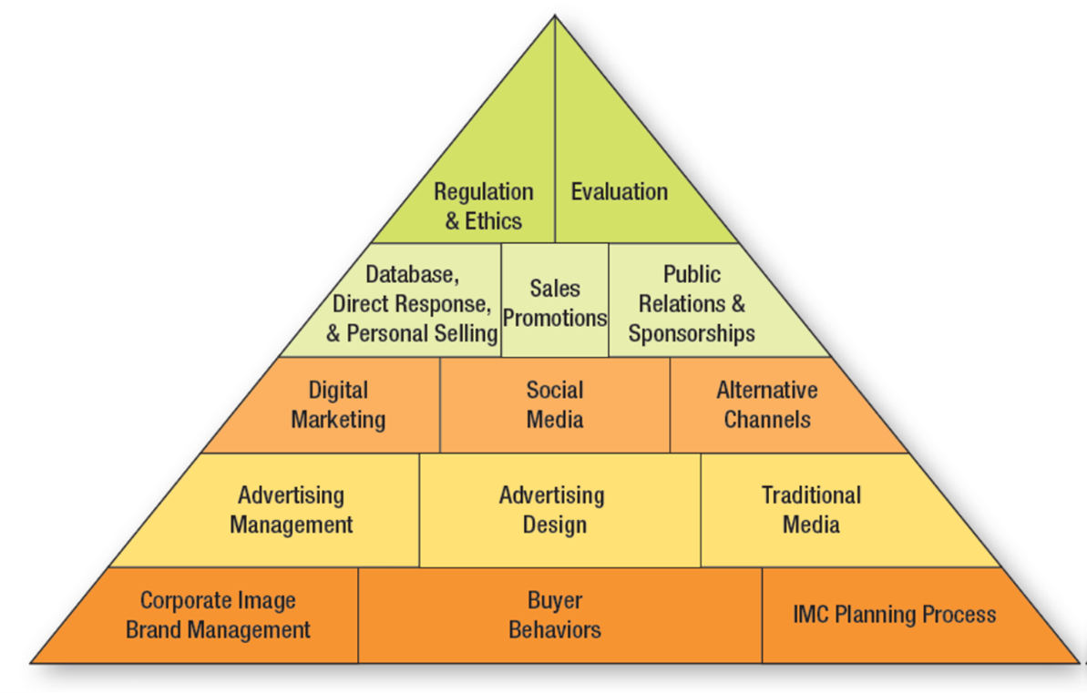
Figure 1.8: Overview of I M C Text
Notes:
This pyramid represents the structure of the text. Section 1 (bottom level) deals with issues such as brand management, buyer behaviors, and the IMC planning process. Section 2 (second level) deals with advertising-related issues. Section 3 (third level) discusses digital, mobile, and alternative channels. Section 4 (fourth level) addresses database and direct response marketing, sales promotions, and public relations. The final section of the book (top level) concludes with discussions on regulations, ethics, and an evaluation of the IMC effort.
The pyramid represents the structure of the text in five sections as follows. Section 1 (bottom level) deals with issues such as corporate image brand management, buyer behaviors, and the IMC planning process. Section 2 (second level) deals with advertising management, advertising design, and the traditional media. Section 3 (third level) discusses digital marketing, social media, and alternative channels. Section 4 (fourth level) addresses database and direct response marketing, sales promotions, and public relations and sponsorships. The final section 5 of the book (top level) concludes with discussions on regulations, ethics, and an evaluation of the IMC effort.

Slide 28

International Implications
G I M C: Global Integrated Marketing Communications
Goal: to coordinate marketing efforts
Challenge due to national, cultural differences
Standardization versus Adaptation
Notes:
Because of the increase in global competition, firms must coordinate marketing efforts across multiple countries. Because of cultural differences and language differences, it is a greater challenge. Firms can use a standardized approach which means the same approach and message is used in every global market. This works only for global brands that are worldwide and well known. An alternative is adaptation, which means firms adapt their marketing communications to each country, region, and culture.

Slide 29
Blog Exercises
Gas station advertising
Facebook
Communication patterns
Notes:
The blog exercises for Chapter 1 include gas station advertising, Facebook, and communication patterns, along with videos about integrated marketing. Links are embedded in the text for each.

Slide 30

Copyright
This work is protected by United States copyright laws and is provided solely for the use of instructors in teaching their courses and assessing student learning. Dissemination or sale of any part of this work (including on the World Wide Web) will destroy the integrity of the work and is not permitted. The work and materials from it should never be made available to students except by instructors using the accompanying text in their classes. All recipients of this work are expected to abide by these restrictions and to honor the intended pedagogical purposes and the needs of other instructors who rely on these materials.

